Slide 1
Lens and propagation of uncertainty
PHY 105N

Slide 2
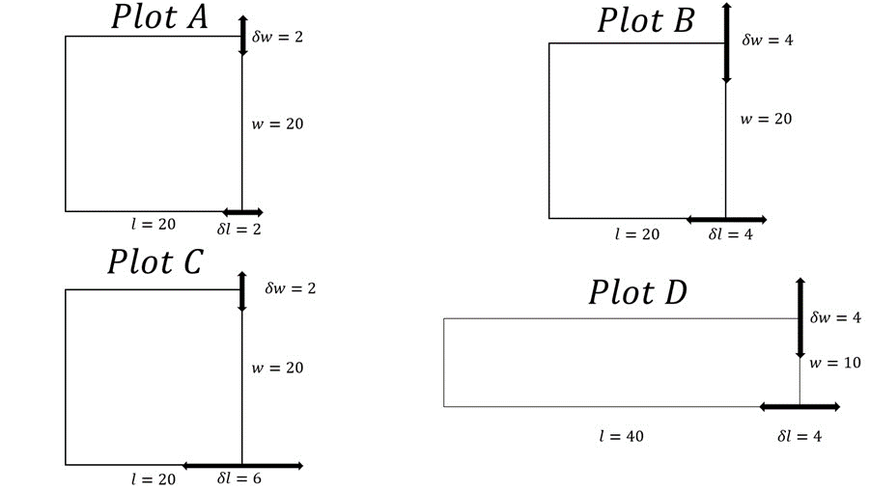
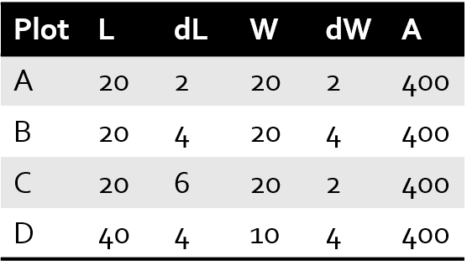
Prelab on uncertainty
So, how do we determine dA?

Slide 3
Prelab on uncertainty
Ideas
Attempt #1:
A ± dA = (L ± dL) ∙ (W ± dW)
A ± dA = LW ± LdW ± WdL + dLdW
Subtract or add? Equally likely
This feels uncomfortable
dL*dW | First Guess
4 | 84
16 | 176
12 | 172
16 | 216

Slide 4
Prelab on uncertainty
Attempt #2:
A = L ∙ W
dA is half the range between (L-dL) ∙ (W-dW) and (L+dL) ∙ (W+dW)
For the D plot:
(40-4) ∙ 6 = 216
44 ∙ 14 = 616
Result: ± 200
dL*dW | First Guess | Second Guess
4 | 84 | 80
16 | 176 | 160
12 | 172 | 160
16 | 216 | 200

Slide 5

Prelab on uncertainty
Attempt #3:
A = L ∙ W
dA is sum of percent uncertain for each term
$\frac{dA}{A}= \frac{dL}{L}+\frac{dW}{W}$
dL*dW | First Guess | Second Guess | Third Guess
4 | 84 | 80 | 80
16 | 176 | 160 | 160
12 | 172 | 160 | 160
16 | 216 | 200 | 200

Slide 6
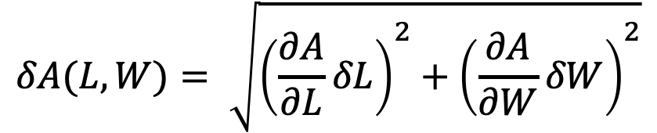
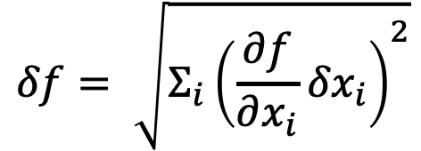
Multivariable Uncertainty Propagation
This formula always works!
$$δf= \sqrt{Σ_{i}{\left(\frac{∂f}{∂x_{i}}{δx}_{i}\right)}^{2}}$$
In general, this is a faultless formula.
Uncertainty propagation gets more complex as more variables depend on each other.
For example, for A that is a function of two variables L and W, then…
$$δA(L,W)= \sqrt{{\left(\frac{∂A}{∂L}δL\right)}^{2}+{\left(\frac{∂A}{∂W}δW\right)}^{2}}$$

Slide 7
Quick Derivative Review
$\frac{∂f}{∂x}$ denotes the partial derivative
Partial derivates work in mostly the same way that normal derivatives work, except that they involve functions of more than one variable.
The denominator shows the variable of interest. All other variables in the equation are treated as constants during partial derivation.
A trick to make this easier sometimes is to replace all other variables with specific numbers, like π, A, or 100, so long as you keep track of that.

Slide 8

Prelab on uncertainty
Final answer:
$$dA= \sqrt{(LdW)^{2}+(WdL)^{2}}$$
dL*dW | First Guess | Second Guess | Third Guess | Final Guess
4 | 84 | 80 | 80 | 57
16 | 176 | 160 | 160 | 113
12 | 172 | 160 | 160 | 126
16 | 216 | 200 | 200 | 165
*Remember to follow proper conventions with rounding/sig figs when reporting uncertainty.

Slide 9
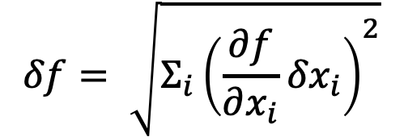
Propagation of Uncertainty
STEP BY STEP
1. Identify the given number of variables and their uncertainties.
2. Determine the mathematical relationship
3. Apply the formula
4. Calculate the partial derivatives
5. Calculate the uncertainty
For example, if f is a function of two variables, then…
$$δf= \sqrt{Σ_{i}{\left(\frac{∂f}{∂x_{i}}{δx}_{i}\right)}^{2}}$$

Slide 10
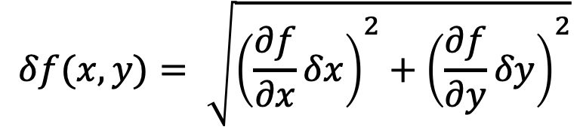
Propagation of Uncertainty
STEP BY STEP
1. Identify the given number of variables and their uncertainties.
2. Determine the mathematical relationship
3. Apply the formula
4. Calculate the partial derivatives
5. Calculate the uncertainty
For example, if f is a function of two variables, then…
$$δf(x,y)= \sqrt{{\left(\frac{∂f}{∂x}δx\right)}^{2}+{\left(\frac{∂f}{∂y}δy\right)}^{2}}$$
$$δf= \sqrt{Σ_{i}{\left(\frac{∂f}{∂x_{i}}{δx}_{i}\right)}^{2}}$$

Slide 11
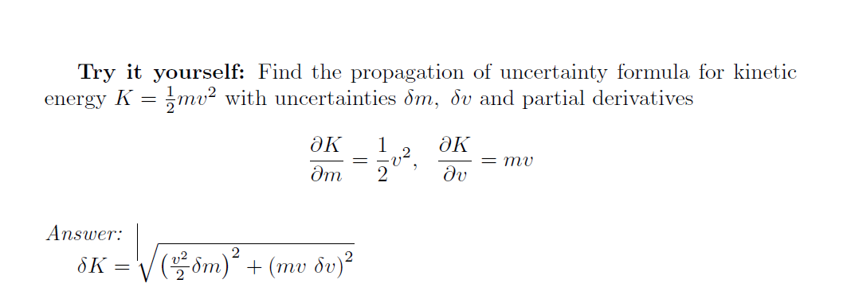
[Lab 3] Propagation of Uncertainty

Slide 12

[Lab 3] Propagation of Uncertainty

Slide 13
Questions?

Slide 14

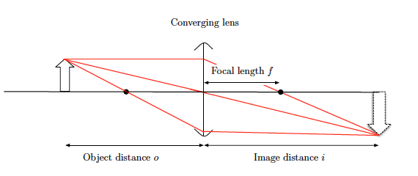
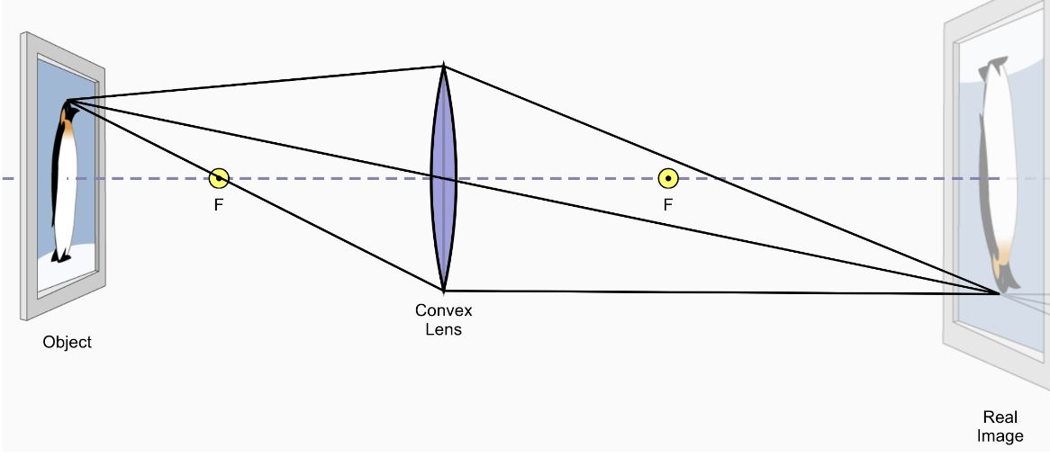
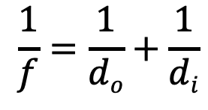
Thin Lenses
$$\frac{1}{f}=\frac{1}{do}+\frac{1}{di}$$

Slide 15
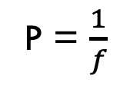
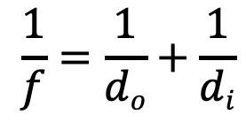
Helpful equations
Optical Power :
Optical Equation :
Optical equation goes by many names: thin lens equation, lens equation, etc. and can use different variable symbols (p, s, o,)
P = $\frac{1}{f}$
$$\frac{1}{f}=\frac{1}{do}+\frac{1}{di}$$

Slide 16
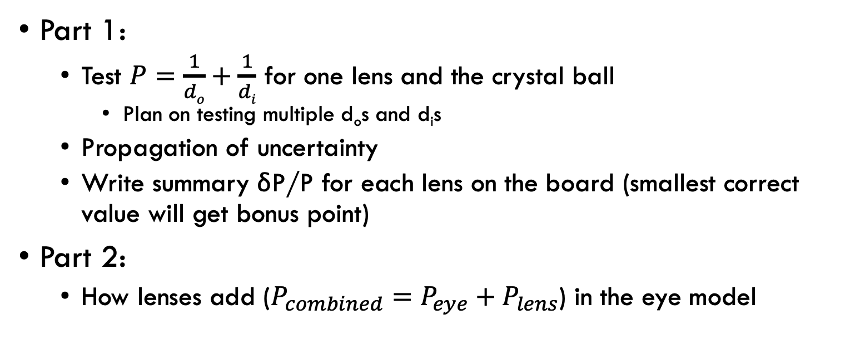
LAB 3
Part 1:
Test $P=\frac{1}{do}+\frac{1}{di}$ for one lens and the crystal ball
Plan on testing multiple d_{o}s and d_{i}s
Propagation of uncertainty
Write summary δP/P for each lens on the board (smallest correct value will get bonus point)
Part 2:
How lenses add ($P_{combined}=P_{eye}+P_{lens}$) in the eye model

Slide 17
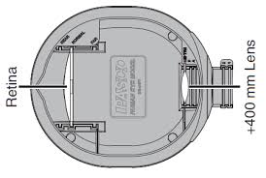
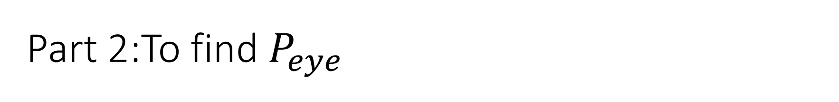

Part 2:To find $P_{eye}$
d_{i} = image distance
d_{i}
Pasco Light source
d_{o} = object distance
+62mm
$P_{eye}=\frac{1}{do}+\frac{1}{di}$

Slide 18
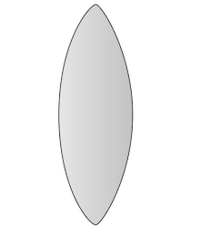
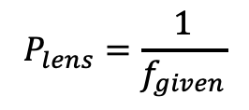
Add a corrective lens
$$f_{given}$$
d_{i} = image distance
Pasco Light source
d_{o} = object distance
+62mm
$$P_{lens}=\frac{1}{f_{given}}$$

Slide 19

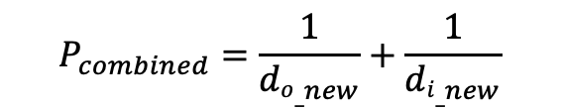

Take measurement again with corrective lens
$${di_}_{new}=image distance with corrective lens$$
Pasco Light source
$${do}_{_new}=object distance with corrective lens$$
+62mm
$$f_{given}$$
Corrective lens
$$P_{combined}=\frac{1}{{do_}_{new}}+\frac{1}{{di_}_{new}}$$

